Slide 1
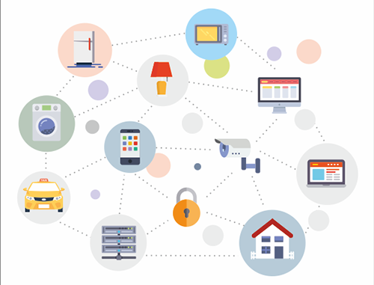
Technological Enablers of IoT
– Technology Behind Internet of Things

Slide 2
Outline
The IoT technology stack
Connectivity solutions within the IoT technology stack

Slide 3
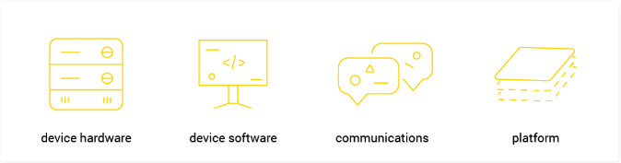
The IoT technology stack
IoT technology stack can be split into four basic technology layers involved in making the Internet of Things work.

Slide 4
Device Hardware
Devices are objects which actually constitute the ‘things’ within the Internet of Things.
Acting as an interface between the real and the digital worlds, they may take different sizes, shapes and levels of technological complexity depending on the task they are required to perform within the specific IoT deployment.
Whether pinhead sized microphones or heavy construction machines, practically every material object can be turned into a connected device by the addition of necessary instrumentation (by adding sensors or actuators along with the appropriate software) to measure and collect the necessary data.
Sensors, actuators or other telemetry gear can also constitute standalone smart devices by themselves.
The only limitation to be encountered here is the actual IoT use case and its hardware requirements (size, ease of deployment and management, reliability, useful lifetime, cost-effectiveness).

Slide 5
Device Software
This is what actually makes the connected devices ‘smart’. Software is responsible for implementing the communication with the Cloud, collecting data, integrating devices as well as performing real-time data analysis within the IoT network.
It is device software that also caters for application level capabilities for users to visualize data and interact with the IoT system.

Slide 6
Communications
Having the device hardware and software in place, there must be another layer which will provide the smart objects with ways and means of exchanging information with the rest of the IoT world.
Communication layer includes both physical connectivity solutions (cellular, satellite, LAN) and specific protocols used in varying IoT environments (ZigBee, Thread, Z-Wave, MQTT, ).
The technology chosen will determine not only the ways in which data is sent to/received from the Cloud, but also how the devices are managed and how they communicate with third party devices.

Slide 7
Platform
An IoT platform is the place where all of these data is gathered, managed, processed, analysed and presented in a user-friendly way.
Thus, what makes such a solution especially valuable is not merely its data collection and management capabilities, but rather its ability to analyse and find useful insights from the portions of data provided by the devices via the communications layer.
Platforms can be either installed on-premise or cloud-based.

Slide 8
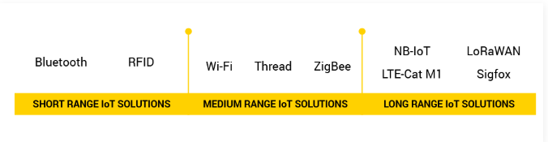
Connectivity solutions within the IoT technology stack
Depending on the specifications of a given IoT use case, each communications option may offer different service enablement scenarios while having tradeoffs between power consumption, range and bandwidth.
Existing Internet protocols, such as Transmission Control Protocol / Internet Protocol (TCP/IP), are often not effective enough and too power-consuming to be able to work efficiently within the emerging IoT technology applications.

Slide 9
Short range IoT network solutions
Bluetooth
Bluetooth is considered to be the key solution particularly for the future of the wearable electronics market such as wireless headphones or geolocation sensors, especially given its widespread integration with smartphones.
Designed with cost-effectiveness and reduced power consumption in mind, the Bluetooth Low-Energy (BLE) protocol requires very little power from the device.
When transferring frequently higher amounts of data, BLE may not be the most effective solution.
RFID
Radio-frequency identification (RFID) offers positioning solutions for IoT applications, especially in supply chain management and logistics, which require the ability of determining the object position inside buildings.

Slide 10
Medium range IoT network solutions
WiFi
Developed based on IEEE 802.11, it is the most widespread and generally known wireless communications protocol.
As a key technology in the development of IoT, WiFi provides a wide-ranging ground to staggering number of IoT solutions, yet it also needs to be managed and used in terms of marketing to yield profits to service providers and users alike.
Zigbee
This popular wireless mesh networking standard finds its most frequent applications in traffic management systems, household electronics, and machine industry.
Built on top of the IEEE 802.15.4 standard, Zigbee supports low data exchange rates, low power operation, security, and reliability.

Slide 11
Medium range IoT network solutions
Thread
Designed specifically for smart home products, Thread employs IPv6 connectivity to enable connected devices to communicate between one another, access services in the cloud, or interact with the user via Thread mobile applications.

Slide 12
Long range IoT network solutions
NB-IOT
A product of existing 3GPP technologies, Narrowband IoT is a brand-new radio technology standard that ensures extremely low power consumption and provides connectivity with signal strength approx. 23 dB lower than in the case of 2G.
It uses existing network infrastructure, which ensures not only global coverage in LTE networks, but also guaranteed signal quality.

Slide 13
Long range IoT network solutions
LTE-Cat M1
LTE-Cat M1 is a low‑power wide‑area (LPWA) connectivity standard that connects IoT and M2M devices with medium data rate requirements.
It supports longer battery lifecycles and offers enhanced in‑building range as compared to cellular technologies such as 2G, 3G, or LTE-Cat 1.
Being compatible with the existing LTE network, CAT M1 doesn’t require the carriers to build new infrastructure to implement it.

Slide 14
Long range IoT network solutions
LoRaWAN
LoRaWAN is a low-power Long Range Wide-Area Networking protocol optimized for low-power consumption and supporting large networks with millions of devices.
Aiming at wide-area network (WAN) applications, LoRaWAN is designed to furnish low-power WANs with features required to support low-cost, mobile and secure bi-directional communication within IoT, M2M, smart city, and industrial applications.

Slide 15
Long range IoT network solutions
Sigfox
The concept behind Sigfox is to provide an effective connectivity solution for low-power M2M applications requiring low levels of data transfer for which the WiFi range is too short, and cellular range is too expensive and too power-hungry.
Offering a robust, energy-efficient and scalable network able to support communication between thousands of thousands of battery-operated devices across areas of several square kilometres, Sigfox proves suitable for various M2M applications, including smart street lighting, intelligent meters, patient monitors, security devices, and environmental sensors.

Slide 16
References
https://www.avsystem.com/blog/iot-technology/
https://www.interact-lighting.com/global/iot-insights/technology-enablers-for-the-internet-of-things
https://www.softwaretestingmagazine.com/knowledge/testing-iot-devices-key-areas/

